Slide 1




Ami | Equity Research Associate
Tionne | Global Asset Mgmt
Susan | Strategy Associate
Chase Leadership Development Program

Slide 2

A leading global financial services firm.
JPMorgan Chase is a global leader in financial services, offering solutions to the world's most important corporations, governments and institutions in more than 100 countries. Working with us means you’ll learn from our team of experts in a supportive and collaborative environment and gain the skills to make a direct contribution to a firm with a legacy lasting over 200 years.

Slide 3

There’s more to JPMorgan Chase than you know – not only are there hundreds of unexpected jobs, but there are millions of ways to gain personal meaning and fulfillment from each one.

Slide 4






Asset & Wealth Management
Our Asset & Wealth Management business provides strategies that encompass the full spectrum of asset classes. Our global investment professionals provide personalized service and advice for individuals, advisors and institutions.
Commercial Banking
Our Commercial Bank provides a range of solutions to help corporations, organizations, real estate investors and business owners achieve their financial goals and leave a positive impact on their communities.
Consumer & Community Banking
Our Consumer & Community Bank serves people, families and businesses by helping them bank, save, invest, make purchases with credit cards, and finance homes and cars.
Corporate & Investment Bank
Our Corporate and Investment Bank is a global leader across banking, markets and investor services, earning the trust of the world's most important corporations, governments and institutions.
Corporate Function
Teams collaborate with internal and external clients seeking expertise to execute business strategies. This includes professionals in compliance, risk management, legal, human resources, marketing and other fields.
Technology
With an $11 billion investment and over 50,000 technologists worldwide, innovation drives the way we do business. Our teams build cutting-edge solutions that impact millions of customers and organizations worldwide.
Notes:
Let’s talk about how we’re organized, and all the areas you can explore in your career.
We are organized by five lines of businesses: Corporate & Investment Banking, Consumer & Community Banking, Commercial Banking, Asset & Wealth Management, Cross-firm functions, which includes technology.
Here are some quick facts on each line of business to give you a sense of what we do and our impact:
Our Corporate & Investment Bank services more than 80% of Fortune 500 companies.
Our Consumer & Community Banking division serves 61Mn U.S. households.
Our Commercial Banking division is the #1 multi-family lender in U.S.
Our Asset & Wealth Management division has a record $1.8 trillion in assets under management
Given our scale and breadth of services, you’ll have several opportunities to explore unchartered territory in financial services – working with exciting brands and clients, and becoming a more well-rounded professional.
Having such a breadth of businesses offers candidates like you a range of opportunities to start their careers as well as build them once they’re here.
Note: Below provides suggested examples. Depending on the programs represented at your event, you’ll want to adopt accordingly.
If you’re interested in helping high-net-worth individuals preserve their wealth, then a role in Asset Management’s Global Wealth Management may be right for you.
If you’re interested in helping a Fortune 500 global company expand their business through an acquisition, then a Banking role in CIB might be right for you.
If you’re interested in developing business strategies for internal clients, then a corporate role in Operations might be right for you.
If you’re interested in helping medium-sized companies expand internationally, then a Banking role in CB might be right for you.
If you’re interested in working with individuals to help them manage their financial goals, then a role in Card Services in CCB might be right for you.

Slide 5
JPMORGANCHASE.COM/CAREERS

Slide 6
Engage in high impact projects to provide best-in-class industry solutions.
Consumer & Community Banking
    As part of the Chase Leadership Development Program, you’ll get a comprehensive look of Chase, focused on matters that are value-add to our business and have a real-life impact on our customers.
    Build upon your analytical, marketing and strategic thinking skills, while adding real value to key CCB initiatives. We offer a framework for career growth through unmatched training and exciting experiences and access across our businesses. Our collaborative culture is designed to support YOUR success — wherever it takes you
Notes:
Utilizing data analytics to measure operational effectiveness, support risk/reward related business decisions, as well as assess and forecast profit;
Developing business cases for new and innovative digital features and/or functionality;
Project management efforts for high visibility of our brands, inclusive of marketing & media initiatives;
Evaluating and quantifying business strategies in line with regulatory controls; and
Strategizing marketing initiatives, loss and performance metrics for the various Chase products and services.

Slide 7
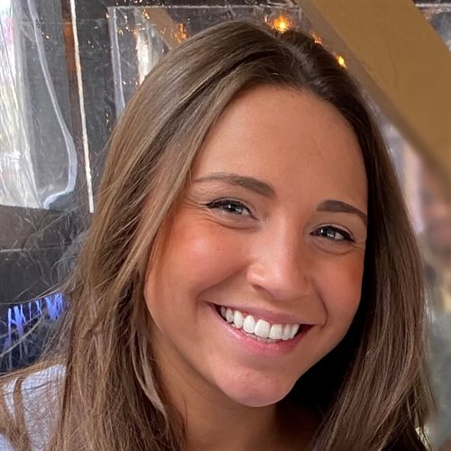
Natalie
Analyst, CLDP
“The Chase Leadership Development Program will provide you with a diverse skillset working across different businesses, as you gain a deep understanding of how we operate as a company and serve our customers. You will network with senior employees and interact with fellow Analysts. Everyone is willing to help you jump start and grow your career.”

Slide 8
Chase Leadership Development Program
You will influence one of our Chase business units
Chase Wealth Management
Business Banking
Consumer Banking
Home Lending
Auto
Card Services
A general management program within Consumer & Community Banking (CCB) structured to enhance your business acumen while further developing your professional and technical skills
Summer Analyst Program
Up to a 10-week internship tied to CCB business priorities and growth strategies.
Full-Time Analyst
Three 8-month rotations supporting different Lines of Business’ and/or functions within CCB through high impact projects
Columbus Metro
New York Metro
Wilmington, DE
cldp.campus.recruitment@chase.com
Dallas Metro

Slide 9
Career Prep 101
Constructing Your Candidacy
Building a Strong Application

Slide 10


Interview Process
1. How to prepare
Be ready to share specific examples of your previous experience that reflect transferrable skills to the opportunity you are applying for. Prepare questions for our team, so you can learn more about the opportunity and our firm.
2. Interviews
For virtual or phone interviews, test technology and connection prior to your interview to avoid any last-minute technical difficulties. And make sure you take the interview from a quiet, uninterrupted area. Interview processes vary by program but will typically include multiple rounds.
Our interview process is not only a chance for us to get to know you better, but for you to learn more about us too. If you are advanced to the next step of the process, we'll contact you with interview details. This can be conducted by phone, virtually or in person, depending on the opportunity and where you are in the process.
3. Assessment
Before you record your video responses, you have unlimited time to practice to help you get comfortable with the technology first. Once you start recording your video response, you will also have one opportunity to re-record each response if desired.

Slide 11
Prepare! Prepare! Prepare!
Attend presentations and get to know members of the recruiting team
Seek out students who interned at the firms in which you are interested
Know the differences between firms and their competitors
Prepare for all interviews/meetings
  Take advantage of workshops and educational sessions offered
  Keep current on general business news
  Utilize Career Center résumé and interview workshops
  Become active in clubs in your area of interest
Constructing Your Candidacy
“You may not always be the smartest one in the room, but you can be the one who is the most determined to succeed.”

Slide 12
Know Your Story
Be able to clearly articulate your candidacy
Build your story around these critical questions:
  Why this industry?
  What area in the firm interests you and why?
  Why are you a good fit?
  What steps have you taken to prepare yourself to be an Analyst?
Constructing Your Candidacy
This is your elevator pitch. Be confident. Be Brave. And knock them out of the park.

Slide 13
Start with a Strong Resume
Constructing Your Candidacy
“Your resume is a 2-D portrait of yourself. You want your resume to tell a story but more importantly tell the story of why you are the best fit for this role.”

Slide 14
What makes a good resume?
THE LOOK
THE WORDS
THE EXPERIENCE
Length – one page maximum
Content – clear, concise and relevant
Presentation
  Error free – proofread
  Use correct tense
  Consistent formatting and font
Name
Contact Information
Education (including honors and academic awards)
Work Experience
Extracurricular Activities
Awards
Skills/Language
Interests
*Save as a PDF before emailing it!*
  Start with action words (analyzed, coordinated, evaluated, implemented, produced, etc.)
  Describe/emphasize major projects or responsibilities
  Highlight teamwork with words like “assisted” or “contributed”
  Include value added (i.e. increased efficiency, reduced cost); quantify/use numbers wherever possible
Notes:
Remember:
Have others review your résumé and give feedback
Your résumé is a written representation of yourself
Everything on your résumé is fair game in an interview
Do not write anything that you cannot speak about in detail
Deliver important information via bullet points to résumé readers
Use a professional email address that is not your school email address

Slide 15
Preparing for your interview
Know the job
    Understand what the firm does, its competitors, and how it distinguishes itself in the marketplace
Showcase what you have to offer
    Tell them why you’re the best! Qualifications are not always the only thing considered in a hiring decision. The person who scores the job is often the person who does the best selling themselves by responding thoughtfully to questions and showcasing what they have to offer the job and the team. Who are you as a candidate?
Know your application
    Know your resume inside and out, review it prior to the interview and be prepared to speak to any part of it. Have someone review it, discuss it with you and give you feedback.
Write down your responses
    And say them out loud. Eventually, the answers to these questions will become easy to speak to and you will feel more confident discussing these areas with a hiring manager
Constructing Your Candidacy
You’ve made it! You are at the interview stage, it is your time to shine. Take a deep breath because you totally have this!
Notes:
Understand what the firm does, its competitors, and how it distinguishes itself in the marketplace
This will allow you to ask more sophisticated questions and help you avoid embarrassing ones
Focus your preparation on:
Overview of the industry
Role of an analyst
Business of the company – if it’s a public company, review their annual report or 10K (available on-line)
Firm’s marketing strategies – you can gather most of this information from information sessions and recruiting web page
Background of the person interviewing (if possible)
Be enthusiastic about the industry and the firm
Arrange informational meeting(s) if you have or make any connections in the finance world
Check with your Career Services for mock interviews & resume reviews. These can be very valuable!
Dress professionally, bring extra copies of your résumé, and (if needed) bring water and/or napkins if you tend to sweat in nervous situations

Slide 16
Interview: First Impressions
Constructing Your Candidacy
A job interview doesn’t start with the first question. Hiring managers begin to assess candidates from the moment they arrive. Here are some things to consider as you walk through those interview doors (or join that video call):
Arrival time Attire
Body Language Communication Preparedness Enthusiasm
Are you on time?
Are you well groomed and professional?
Are you making eye contact? How is your posture?
Are you positive, polite and inquisitive?
Did you bring your resume or other supplies?
Did you flash a smile or raise your eyebrows?

Slide 17
What makes a good interviewee?
Speak calmly, professionally, and intelligently
Be prepared to demonstrate key attributes you possess, such as:
Admit it when you do not know answers to questions—you are not expected to know everything
Constructing Your Candidacy
    Quantitative skills
    Teamwork
    Leadership
    Poise under pressure
    Diversity of experience
    Character
    Enthusiasm
    Interest
Be able to articulate why you are a good fit and relate your prior experience to this specific opportunity
Notes:
Speak calmly, professionally, and intelligently when interviewer asks questions
Expect these general questions:
Tell me about yourself/walk me through your resume
Why did you choose your school/your major?
Tell us about a time you were a leader/worked with a team
Why this industry and specifically why this firm?
Be able to articulate why you are a good fit and relate your prior experience to this specific opportunity
Keep in mind why the interviewer is asking specific questions in an attempt to exhibit specific attributes such as:
Interest/Passion/Curiosity
Intelligence
Teamwork
Leadership
Diversity of Experience
Poise Under Pressure
Quantitative Skills/Interest in the Markets

Slide 18
Interview: Finish Strong
Ask insightful questions
  Prepare 3-5 questions
  Ask at least 3 of them during the interview
Close the deal
  Reiterate interest
  Next steps/timeline
  Express gratitude
Constructing Your Candidacy
Show your passion for the role and let the interviewers know you want the job. Push yourself above the competition as this is your final chance. Make it count!
Notes:
Critical opportunity for interviewer to decide whether or not to ask you back for another round/extend an offer
Push yourself above the competition as this is your final chance, especially if you are a borderline candidate
Show your passion for the role and let the interviewers know you want the job
Have smart questions prepared to ask the interviewer
Ex: What differentiates a good analyst from a great analyst? – can provide a gold mine of information
Incorporate the answers of these questions into thank you notes and future interviews
Shake hands again upon leaving and thank him/her for their time; take a business card if they have one
Don’t be afraid to close the interview by stating why would want this internship and why would be a great fit!
Don’t just focus on answering questions; you’re there to ask questions too. When done correctly, the questions you ask confirm your qualifications as a candidate for the position.
Close the deal: Finally, as the interview winds down, ask what the next steps are in the process and the timetable for the employer to make a decision about the position.
Remember to convey confidence and positive body language as you make your exit.

Slide 19
After the Interview: Follow-Up
Thank you note
  Both email and snail mail are appropriate for thank-you letters with obvious advantages and disadvantages to both. Email is recommended for promptness
  Generally, the more senior the interviewer, the more formal your approach should be
  Customize your notes! Avoid using copy & paste to send the same note to everyone you meet
Constructing Your Candidacy
The best way to make your interview unforgettable is to close out the interview with a personalized thank you note.
Notes:
Reflect and self-evaluate – no better teacher than history
As soon as you have time, sit down and go over the highlights and low-lights of your interview
Thank you note
Both email and snail mail are appropriate for thank-you letters with obvious advantages and disadvantages to both. Email is recommended for promptness
Generally, the more senior the interviewer, the more formal your approach should be
Customize your notes! Avoid using copy & paste to send the same note to everyone you meet

Slide 20
You have the tips, now let’s apply!
Building a Strong Application
On the next couple slides we are going to walk you through the application process. We will talk about what to expect and how to prepare for each step.

Slide 21

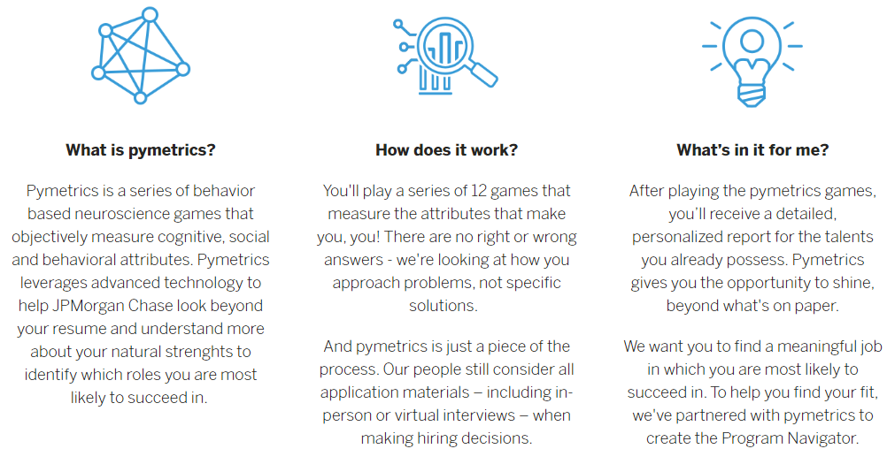
Application: Pymetrics
Notes:
We’re looking for students from all majors and backgrounds to join our diverse, global team. But with so many different career opportunities available to you at our firm, we want to make it easier for you to explore programs based on who you are as an individual and how you think. Our ultimate goal is to help find the right program for you.
That's why we've partnered with pymetrics, a game-based platform that measures social, cognitive and behavioral attributes.
After completing the games, you can view a short list of programs tailored to you, as well as a personalized report to help you learn more about yourself. However, you're welcome to explore any other opportunities we have to offer!
If you choose to apply to a program that uses pymetrics as part of its application, you won't need to replay the games.
We want to make it easier for you to explore programs based on who you are as an individual and how you think. Our ultimate-goal is to help find the right program for you.
Pymetrics is a game-based platform that measures social, cognitive and behavioral attributes.
After completing the games, you can view a short list of programs tailored to you, as well as a personalized report to help you learn more about yourself.

Slide 22
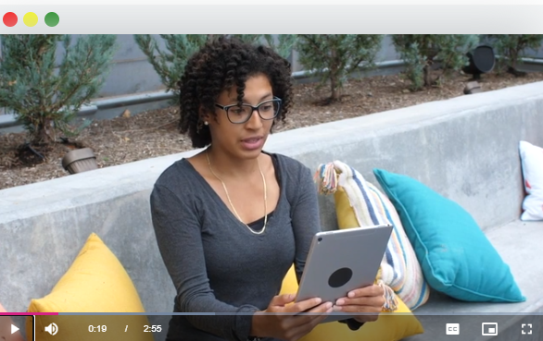
Application: HireVue
Tips for Interview Preparation
Familiarize yourself with the company culture and history
  Company Social Media & Website
Rehearse and practice common interview questions
Get comfortable in front of the camera
Tips for Setting-Up for your Interview
Distraction free environment
Check your lighting, positioning and background
Look professional
Use a compatible device – test your device beforehand
Tips for Completing the interview
Complete the practice questions
Speak slowly and clearly
Dress like you would during an in-person interview
Be yourself!
Notes:
Distraction free environment- Keep in mind that everything your webcam sees (which is more than you think), and your microphone hears, in the background is recorded. A quiet, distraction free area helps you give the best impression possible.
Check your lighting, position and background - Ideally, place a source of light in front of you, and avoid sources of bright light (i.e. windows) directly behind you, as this can make it hard to see your face.
Look professional - Recommend that you wear exactly what you would for a traditional face-to-face interview
Use a compatible device - You can use an Android or Apple smartphone or tablet with a front facing camera, Apple computer with a webcam and microphone.
Most computers have a built-in webcam and microphone or you can use an external webcam and microphone
Practice Questions- Taking the practice questions will help you get comfortable with the style and timing of an On Demand interview.
These are not your real interview questions, and they will not be seen by the company
Be yourself- best tip I can give you, is do not read your answers. It’s super obvious… some of yalla are thinking mmhm that what she thinks but little does she know I read my answer on my hirevue to come to this event… no trust me I knew.. * joke about how it looks when they read* and come in with confidence. Lots of people applied to the position and not everyone received the hirevue- but you did. You received it cause the recruiter had confidence you could sussed so this your time to shine and put your best foot forward. Have confidence inyourself and your answers.

Slide 23





2021 – 2022 Recruiting Timeline
Junior Year
Senior Year
Post-Grad
April-July 2021 | July – Sept 2021 | Sept – Dec 2021 | June – Aug 2022 | August 2022 | July- August 2023
Apply to Summer Internship | Interview at a Super Day or an EIP (Early Identification Program) | Receive and Accept Summer Internship | Complete 9-week Summer Internship | Receive and Accept Offer for Full Time Program | Attend Full Time Induction Training

Slide 24
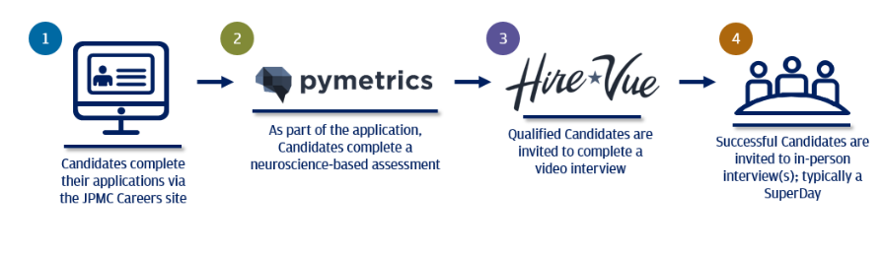
Application Process Summary

Slide 25
Questions?
Contact Us!
cldp.campus.recruitment@chase.com

